Slide 1
Quiz Master
A python command line application for Quiz
-Rashmi Singh

Slide 2
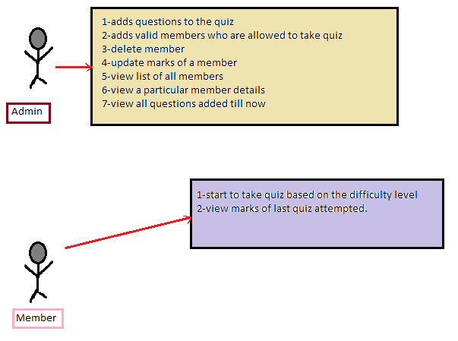
Use Case Diagram:

Slide 3
Demo:

